Slide 1
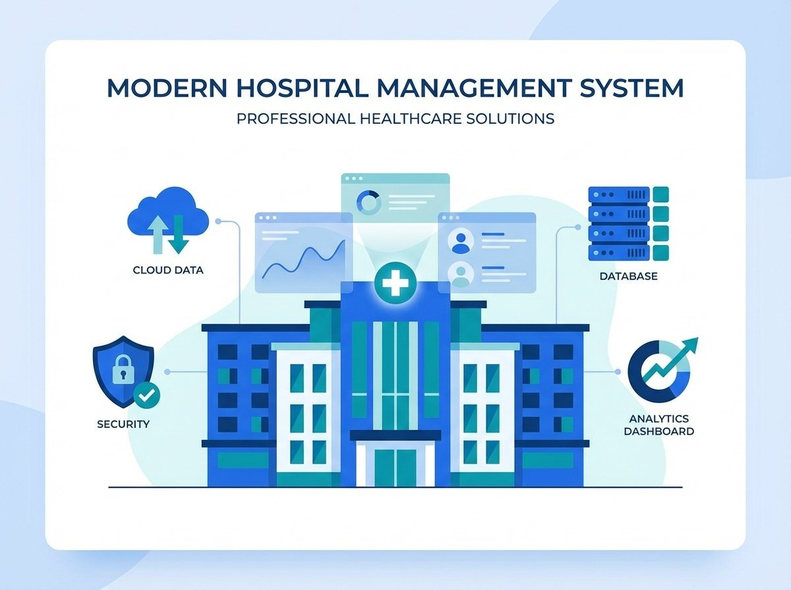
LAKE RIDGE COMMUNITY HOSPITAL
MANAGEMENT
SYSTEM
Group 6: Six and Stones

Slide 2

INTRODUCTION
LRCH’s current systems are disconnected and slow. We propose a unified database that delivers real-time access, accurate data, and smoother workflows across the hospital.
WHY IT MATTERS
Eliminates delays from batch processing
Reduces errors from scattered systems
Supports growing patient volume
Improves staff efficiency and data reliability
OUR VISION
A single platform that supports quick decision-making, reduces errors, enhances patient care, and gives LRCH leadership the tools they need to manage operations efficiently and confidently.
MISSION & OBJECTIVES
Group 6: Six and Stones
SYSTEM OVERVIEW

Slide 3
Records & Clinical
Allow medical staff to record and report the results of laboratory tests and procedures directly into the patient file.
Enable medical staff to assign, store, and retrieve treatment prescriptions as part of a patient’s comprehensive medical record.
Access & Retrieval
Support immediate system-wide access for patient registration and billing inquiries to ensure operational efficiency.
Allow quick retrieval of patient records by unique patient number, or by a combination of patient name and phone number.
Movement & Finance
Update patient location and admission details automatically upon re-admission.
Maintain a complete history of patient locations across visits to support effective contact-tracing.
Archive records three years after the last discharge if not readmitted.
PATIENT MANAGEMENT
Group 6: Six and Stones
SYSTEM OVERVIEW

Slide 4
Staff Registration
Create staff records including ID, name, role, department, contact info, and login credentials.
Staff Management
Retrieve records by ID/name/dept; update roles, contacts, and transfers authorized users.
Staff Offboarding
Delete active records upon exit and ensure archival of historical data for audit purposes.
Hospital Profile Creation
Create hospital records with ID, name, address and contact info
Facility Lifecycle
Update capacity/services; delete records on closure/merge with mandatory data archival.
RECORD MANAGEMENT
Group 6: Six and Stones
SYSTEM OVERVIEW

Slide 5
REPORT MANAGEMENT
Cost Accumulation
Track and accumulate operational costs by specific departments and cost centers.
Daily Room Utilization: Generate comprehensive reports showing hospital room occupancy
Physician Records:
Maintain detailed profiles including ID, name, specialty, and contact information.
Revenue Reporting
Generate daily revenue by patient and weekly analysis by payment method.
Patient Billing
Issue detailed statements with charges, cost centers, and balances due.
Daily Reporting:
Generate daily reports listing admitted patients referred by specific physicians for streamlined rounds.
Group 6: Six and Stones
SYSTEM OVERVIEW

Slide 6
PERFORMANCE & SCALABILITY
1
2
3
Uptime & Recovery
Maintain 98% annual system uptime to ensure continuous hospital operations.
Implement automated backup procedures to recover from critical failures within 5 minutes.
Performance & Availability
Ensure real-time system-wide access for admissions staff and billing inquiries.
Scalability & Config
Support infrastructure expansion from 100 to 200 beds without major architectural redesign.
Enable administrators to update cost center definitions dynamically without system downtime.
Group 6: Six and Stones
SYSTEM OVERVIEW

Slide 7

Transaction & Concurrency Control in the LRCH Database
Room & Bed Allocation
Checks current bookings before adding a new one, so only one booking goes through and conflicts are avoided.
Type (Shared Locks)
Used when multiple staff check room or bed availability, allowing multiple users to read the same data while blocking changes, so everyone sees accurate, up‑to‑date information even during periods of high activity
Level (Row-Level Locks)
Applied when inserting or updating a booking, restricting changes to the specific room or bed record to prevent double-booking while keeping the system responsive by allowing other bookings to proceed in parallel.
Patient Actions & History Updates
Controls how updates happen so only one update is processed at a time, keeping the patient's history correct.
Type (Shared Locks)
Used when viewing a patient’s history, allowing safe, simultaneous reads while blocking changes so staff always see consistent and complete information.
Level (Row-Level Locks)
Applied when adding or updating a patient history entry, preventing multiple staff from editing the same record simultaneously and ensuring accurate, chronological logs for treatments, billing, and patient actions
Atomicity
Consistency
Isolation
Durability
Serialization
Group 6: Six and Stones
SYSTEM OVERVIEW

Slide 8
The LRCH database system provides a secure and organized way to manage patient records, bookings, treatments, items, staff activity, and billing. Its structure ensures that all hospital data is connected, accurate, and available in real time, replacing the delays and errors of paper-based processes.
Through strong transaction and concurrency control, the system prevents conflicts such as double-booking, duplicate charges, and incomplete updates. This keeps information consistent and reliable across all departments. Overall, the database fulfills LRCH’s mission by improving efficiency, supporting better patient care, and creating a dependable foundation for future hospital operations.
Conclusion & Key Takeaways
Group 6: Six and Stones
SYSTEM OVERVIEW

